Slide 1
Lab Assignment: LSTM for ECG Heartbeat Classification

Slide 2
Assignment 1
Develop a Long Short-Term Memory (LSTM) based deep learning model to classify ECG heartbeat signals into different categories. The objective is to understand how sequential deep learning models can be used to analyze time-series medical data and improve automatic diagnosis of heart diseases.

Slide 3
Dataset Overview
Dataset: MIT-BIH Arrhythmia Dataset
Number of Samples: 109,446
Number of Classes: 5
Sampling Frequency: 125 Hz
Signal Length: 187 timesteps
Heartbeat Classes:
Normal
Supraventricular ectopic beats
Ventricular ectopic beats
Fusion beats
Unknown beats
Dataset link: https://www.kaggle.com/datasets/shayanfazeli/heartbeat

Slide 4
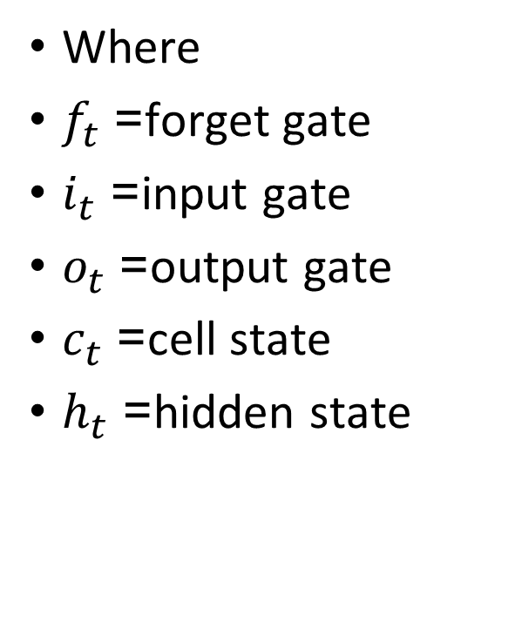
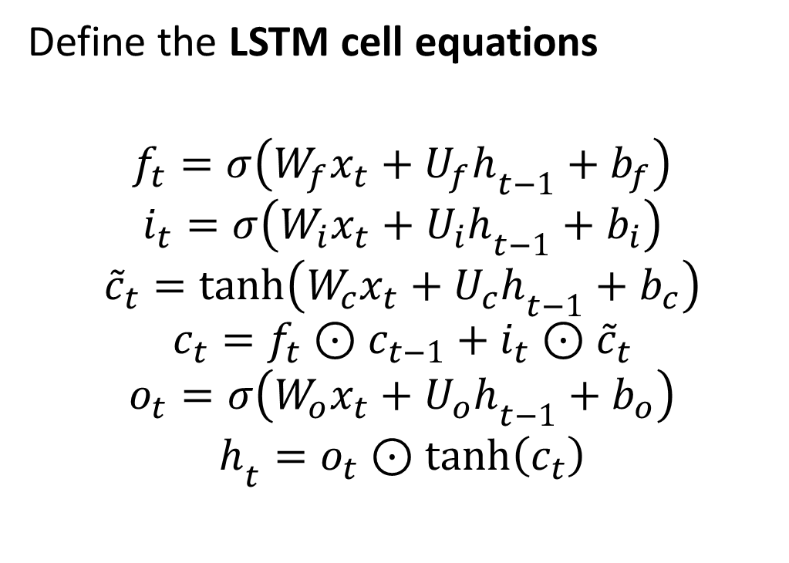
LSTM Architecture Overview
Define the LSTM cell equations
$$f_{t}=σ\left(W_{f}x_{t}+U_{f}h_{t−1}+b_{f}\right)$$
$$i_{t}=σ\left(W_{i}x_{t}+U_{i}h_{t−1}+b_{i}\right)$$
$${\tilde{c}}_{t}=tanh⁡\left(W_{c}x_{t}+U_{c}h_{t−1}+b_{c}\right)$$
$$c_{t}=f_{t}⊙c_{t−1}+i_{t}⊙{\tilde{c}}_{t}$$
$$o_{t}=σ\left(W_{o}x_{t}+U_{o}h_{t−1}+b_{o}\right)$$
$$h_{t}=o_{t}⊙tanh⁡\left(c_{t}\right)$$
Where
$f_{t}$= forget gate
$i_{t}$= input gate
$o_{t}$= output gate
$c_{t}$= cell state
$h_{t}$= hidden state

Slide 5
Data Processing
Load the ECG dataset.
mitbih_train.csv
mitbih_test.csv
Each row contains:187 ECG signal values + label
Separate the dataset into:
Features (ECG signals): X = first 187 columns
Labels (heartbeat classes): y = last column
Normalize them between 0 and 1.
x_norm = (x − x_min) / (x_max − x_min)
Split the training data into: 80% Training20% Validation
Reshaping for LSTM: X_train = X_train.reshape(-1, 187, 1)

Slide 6
Build the LSTM Model
Architecture:
1️⃣ LSTM Layer 2️⃣ Dense Layer 3️⃣ Output Layer
model = Sequential()
model.add(LSTM(64, input_shape=(187,1)))
model.add(Dense(32, activation='relu'))
model.add(Dense(5, activation='softmax'))

Slide 7
Compile and Train the Model
Define:
Loss Function = sparse_categorical_crossentropy
Optimizer = Adam
Evaluation Metrics = Accuracy
Training parameters:
Epochs: 15
Batch size: 64
Early stopping: Monitor validation loss with patience=3.

Slide 8
Evaluate the Model
Evaluate performance on the test set.
Metrics:
Accuracy Plot (Train and validation)
Confusion Matrix
Classification Report

Slide 9
Assignment 2: RNN vs LSTM Comparison
Implement on same dataset:
Simple RNN model
LSTM model
Then compare:
Accuracy plot.

